Slide 1
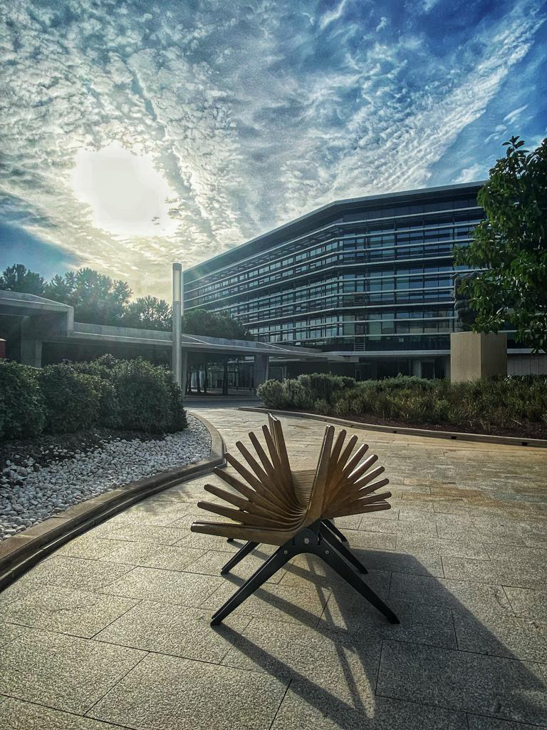
Research Visits at the EUIPO
Alicante, Spain

Slide 2
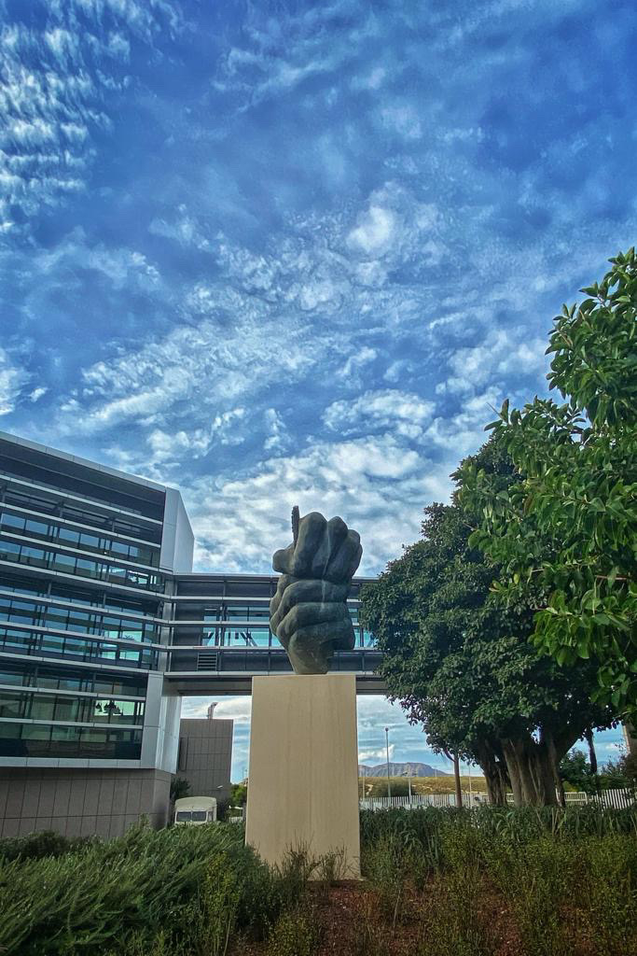
Contents
Overview of the Initiative
Key Information
Short and Long Term Visits
Benefits
How to Apply
EUIPO Library
Academy Learning Portal

Slide 3
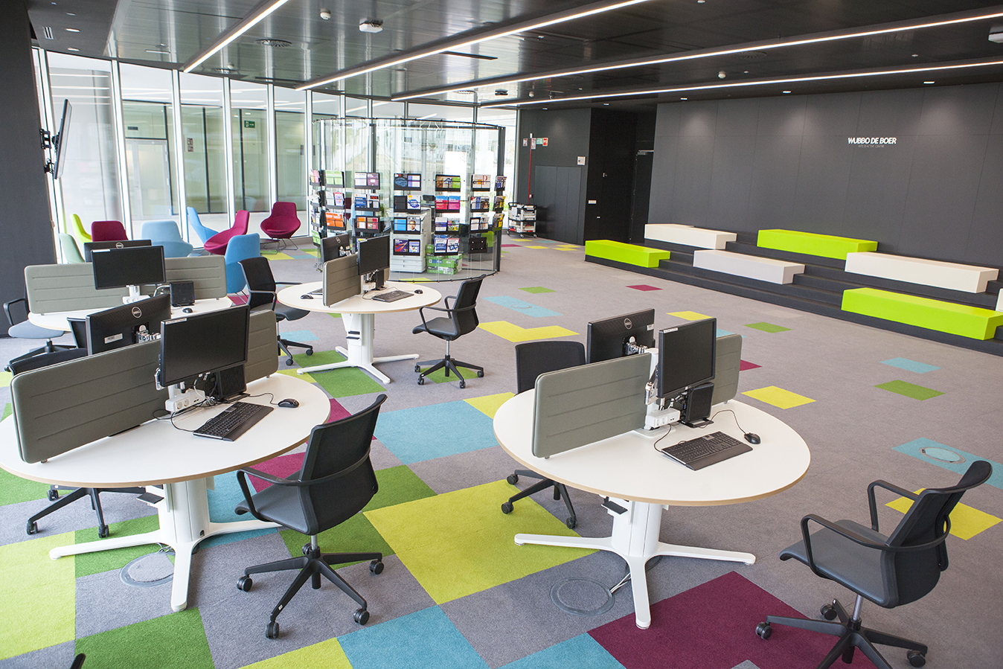
i. Overview
Network of IP Academies
RESEARCH VISITS
Open invitation to researchers of NIPA members to visit the EUIPO Office.
Undertake your research on a subject related to the work of the EUIPO at our premises in Alicante for a fixed time period.
During this period, access all the material, online and offline, found at the EUIPO Library – Knowledge Hub.
Knowledge Sharing
and Research
PURPOSE
Support research on topics relevant for the Office:
EUTM, RCD and GI systems,
IP by SMEs,
IP enforcement,
IP, Innovation & Technology, etc.
Ongoing knowledge sharing with EUIPO’s stakeholders in the academic field.
Strengthen EUIPO’s role as an IP Knowledge Hub.
3

Slide 4
ii. Research Visits: Key Information
 | Short Term Visit | Long Term Visit*
Duration | 1 to 5 days | 15 days to 2 months
Location | Presential at the EUIPO Library
Benefits | Provision of a workstation Access cards as visitors
Additional Benefits | N/A | Consultation with relevant EUIPO experts
*(start either at the beginning (1st – 5th) or the middle (15th – 18th)of the respective month)
Advantages
Access to specific information and knowledge relevance for their research projects.
Access to open content of the Knowledge Hub, our online database, and the possibility of publishing articles, papers and thesis on the Knowledge Hub.
Access to the EUIPO Library and all the relevant material.
4

Slide 5
Research Visits: Application Process
How to Apply
Short Term Visit
Long Term Visit
1. Submit your request for the research visit at least 2 months in advance
1. Submit your request for the research visit at least 3 months in advance
2. Include in your request your research topic and any specific consultation material (books, articles, etc)
2. Include in your request:
your research topic,
any specific material (books, etc),
EUIPO expertise to consult (max. 3).
Applications are accepted throughout the year,
except for the following dates:
15 December to 15 January.
4

Slide 6
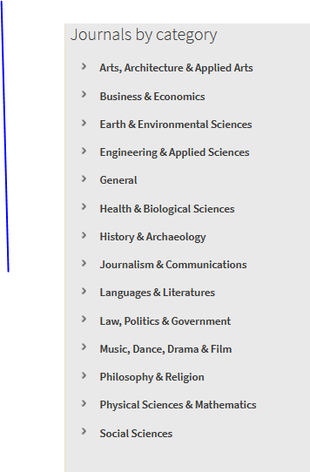
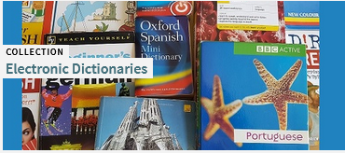
iii. Research Visits – EUIPO LIBRARY
EUIPO LIBRARY
KNOWLEDGE HUB
More than 6 million
References on-line
Books
e-books
dictionaries
encyclopedias
e-journals
articles
databases etc.
Our online home accessible to you.
5

Slide 7
iv. EUIPO – Academy Learning Portal (ALP)
Courses:
Basic
Intermediate
Advanced
→ a training catalogue with a wealth of learning materials
ALP
Knowledge Hub/ EUIPO Library
Webinars:
Live
Recorded
IP and non IP
general IP topics to specific courses covering all aspects of trade mark and design registration.
https://euipo.europa.eu/knowledge/
8

Slide 8
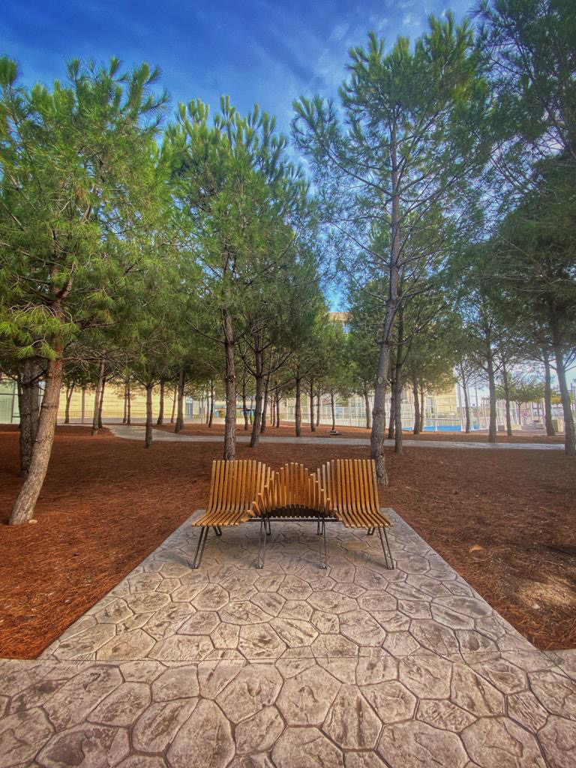
Thank you for your interest in the European Union Intellectual Property Office and our Research Visits Initiative.
Looking forward to meeting you during your research visit.
If you have any questions, please reach out to
PES
Pan_European_Seal@euipo.Europa.eu
Nabil BANHAQ
(nabil.banhaq@euipo.europa.eu)
Alexandros ALEXANDROU (alexandros.alexandrou@euipo.europa.eu)

